Slide 1


VIRTUAL INTELLIGENCE SERVICE
VICTORIA PER INTELLECTUM
HEZBOLLAH: STRUCTURE & GROUND COMBAT TACTICS
INTREP VIS-OPAR-004
DRAFT
DISCLAIMER:
This is for multiplayer online gaming using the Digital Combat Systems simulation software published by Eagle Dynamics. The information is not in any way suitable for real world use or operations.
Version: X.X
Published: YYYY-MM-DD

Slide 2
INTRODUCTION
A
A
Aim:
This document describes the structure of HEZBOLLAH’s armed forces, and how they operate
Content:
High level structure
Sectors HQs
«RADUAN» commando companies
Phases in offensive operations
B
B
C
C
D
D
E
E
F
F

Slide 3
High level structure
HEZBOLLAH’s armed forces operate as a «guerrilla-military» : combining a strict military command& Control structure with guerrilla & insurgency battle tactics.
Supreme leadership body is in direct control of four sector HQs
Supreme Leadership
Sector «WEST»
Sector «SOUTH»
Sector «EAST»
Sector «NORTH»

Slide 4
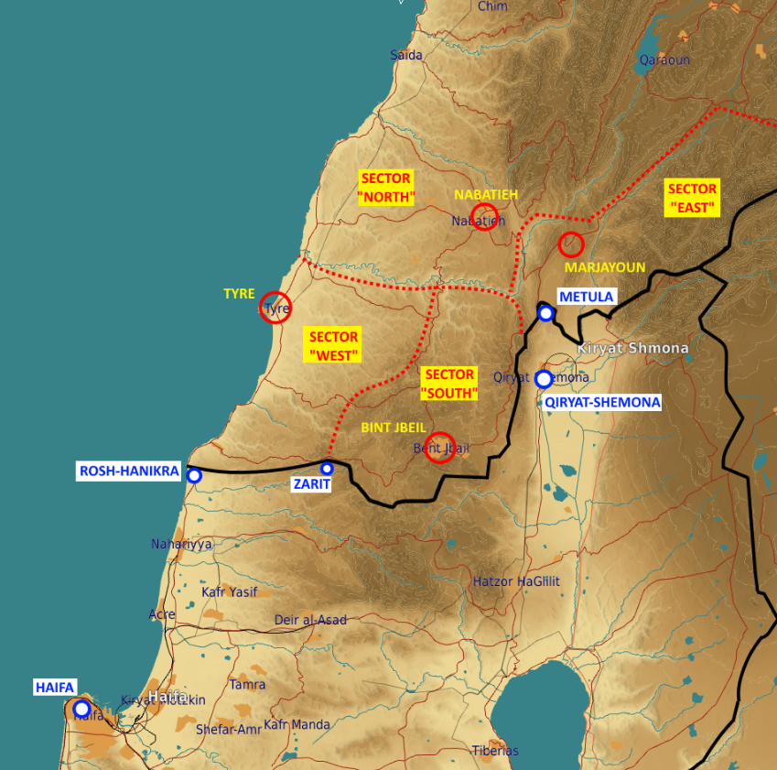
High level structure
Sector «WEST»
HQ at TYRE
Sector «SOUTH»
HQ at BINT JBEIL
Sector «EAST»
HQ at MARJAYOUN
Sector «NORTH»
HQ at NABATEIH
Holds reserves for frontline sectors
Equipped with C-802 anti-ship batteries

Slide 5
SECTOR HQ
Functions:
Control of field assets in their sectors
Sector HQ is authorized to react on Lebanon territory to any Israeli forces incursion.
Any cross-border action must be authorized by supreme leaderhip
FLOT
Front brigade #1
Special Operations Regiment
Recon Regiment
Air Defense Division
Airborne Brigade
SA-8 BN
BN
ROCKETARTY BN
Rocket Artillery Brigade
Motorized Division
Mechanized Division
Missile Brigade
BN
SECTOR HQ
“WEST” and “NORTH” sectors only
BN
BN
LOGISTIC BN
Insurgents BN
Insurgents BN
Logistics Battalion
Air Defense BN
Heavy rocket Artillery BN
Insurgents BN
Insurgents BN
Insurgents BN
Insurgents BN
Medium rocket Artillery BN
Anti-ship battery
ARTY BN
BN
«RADUAN» Company
Insurgents BN
DIV HQ
BN
BN
SA-15 BN
BN
BN
Rear brigade
Front brigade #2

Slide 6
SECTOR HQ
SECTOR HQ
“WEST” and “NORTH” sectors only
Insurgents BN
Insurgents BN
Logistics
Air Defense BN
Heavy rocket Artillery teams
Insurgents BN
Insurgents BN
Insurgents BN
Insurgents BN
Medium rocket Artillery teams
Anti-ship battery
«RADUAN» Company
Insurgents BN
Composition - general notes:
Unlike regular armies, HEZBOLLAH uses civilian vehicles for logistics (resupplies, troops transport and support). This makes intelligence gathering more difficult.
C2 positions are located in regular-looking houses in populated areas. Locations may be provided by higher level intelligence.

Slide 7
INSURGENTS BATTALION
Functions:
Operations against enemy forces within Lebanon territory.
Serve as a supporting force for RADUAN companies in major border-crossing operations.
Composition:
~300 infantry
Transports by means of civ-looking trucks
FLOT
Front brigade #1
Special Operations Regiment
Recon Regiment
Air Defense Division
Airborne Brigade
SA-8 BN
BN
ROCKETARTY BN
Rocket Artillery Brigade
Motorized Division
Mechanized Division
Missile Brigade
BN
BN
BN
LOGISTIC BN
ARTY BN
BN
DIV HQ
BN
BN
SA-15 BN
BN
BN
Rear brigade
Front brigade #2

Slide 8
AIR DEFENSE BATTALION
FLOT
Front brigade #1
Functions:
Defend sector assets against air threats
Equipment:
SA-8s (x2 teams)
Each team consists of 2xSAM vehicles + BRDM APC
SA-9s (x4 teams)
Each team consists of 2xSAM vehicles + BRDM APC
SHILKA SPAAAs (Estimated 8+ units)
ZSU-23 trucks (Estimated 8+ units)
Special Operations Regiment
Recon Regiment
Air Defense Division
Airborne Brigade
SA-8 BN
BN
ROCKETARTY BN
Rocket Artillery Brigade
Motorized Division
Mechanized Division
Missile Brigade
BN
BN
BN
LOGISTIC BN
ARTY BN
BN
DIV HQ
BN
BN
SA-15 BN
BN
BN
Rear brigade
Front brigade #2

Slide 9
ANTI-SHIP BATTERY (Only for Sectors “WEST” and “NORTH”)
FLOT
Front brigade #1
Functions:
Defend against enemy naval assets near Lebanon coastline
Anti-Ship battery equipment:
C-802 launchers (x2)
Silkworm radar (x1)
Auxiliary vehicles (Civ-looking trucks)
Special Operations Regiment
Recon Regiment
Air Defense Division
Airborne Brigade
SA-8 BN
BN
ROCKETARTY BN
Rocket Artillery Brigade
Motorized Division
Mechanized Division
Missile Brigade
BN
BN
BN
LOGISTIC BN
ARTY BN
BN
DIV HQ
BN
BN
SA-15 BN
BN
BN
Rear brigade
Front brigade #2

Slide 10
ARTILLERY TEAMS (HEAVY and MEDIUM)
FLOT
Front brigade #1
Functions:
Heavy fire support for RADUAN operations at or across the border
Strategic weapons against civilian and military targets
Medium Artillery Team - composition:
BM-21 GRAD MLRS (x3 launchers per team)
Civ-looking trucks nearby, used as ammo transports
Heavy Artillery Team - composition:
SMERCH MLRS (x3 launchers per team)
Civ-looking trucks nearby, used as ammo transports
Special Operations Regiment
Recon Regiment
Air Defense Division
Airborne Brigade
SA-8 BN
BN
ROCKETARTY BN
Rocket Artillery Brigade
Motorized Division
Mechanized Division
Missile Brigade
BN
BN
BN
LOGISTIC BN
ARTY BN
BN
DIV HQ
BN
BN
SA-15 BN
BN
BN
Rear brigade
Front brigade #2

Slide 11
“RADUAN” commando compamy
Functions:
Perform quality operation against Israeli forces and civilians across the border
Seizing territories inside Israel (to be used for post-conflict negotiations from position of power)
Equipment:
Infantry platoon: ~40 infantry
Mechanized platoon: BMP-3 (x4)
Mortar artillery platoon: 2B11 Mortars (x4) + BRDM APCs for transportation
MANPAD team : STRELA missile launchers (x3)
FLOT
Front brigade #1
Special Operations Regiment
Recon Regiment
Air Defense Division
Airborne Brigade
SA-8 BN
«RADUAN» Company
BN
ROCKETARTY BN
Rocket Artillery Brigade
Motorized Division
Mechanized Division
Missile Brigade
BN
MANPAD
Team
Mortar artillery platoon
Mechanized platoon
Infantry platoon
BN
Infantry platoon
BN
LOGISTIC BN
ARTY BN
BN
DIV HQ
BN
BN
SA-15 BN
BN
BN
Rear brigade
Front brigade #2

Slide 12
PHASES IN AN OFFENSIVE OPERATION
A
A
B
B
Assembly of forces
Staging
Shaping and assault
(With indicators on each of the phases if possible)
C
C
D
D
E
E
F
F

Slide 13
PHASES IN AN OFFENSIVE OPERATION: ASSEMBLY OF FORCES
A
A
Purpose:
Recruit and assemble combatants in preparation for activity
Activity:
Gathering of troops and equipment
Briefing of troops
Preparation of combat vehicles
Assembly of transports (civ-looking) for logistics support
Duration: (24-48 hrs)
Indicators:
Possible combat vehicles IVO HEZBOLLAH HQs Increased number of trucks IVO HEZBOLLAH HQs
Most likely activity will be indicated via higher-echelon intelligence
B
B
C
C
D
D
E
E
F
F

Slide 14
PHASES IN AN OFFENSIVE OPERATION: STAGING
A
A
Purpose:
Set up forces in starting positions
Activity:
Deployment of troops and combat vehicles in starting positions (3-10km of their objectives
Duration 1-6 hours
Indicators:
Presence of insurgetns and vehicles
B
B
C
C
D
D
E
E
F
F

Slide 15
PHASES IN AN OFFENSIVE OPERATION: SHAPING AND ASSAULT
A
A
Purpose:
Achieve supreme-leadership objectives
Activity:
Artillery fires as distraction or suppresssion
Mortars fire for attacking IDF targets close to the border
Medium-artillery rockets (GRAD) large scale operations (ground maneuver against outposts or civilian population centers
Assault by RADUAN company units (may be followed by an insurgents-battalion when executing large-scale operations)
Indicators:
Reports of artillery impacts (mortars for localized attacks, GRADs for large-scale attacks)
Units consistent of RADUAN companies at or near FLOT
B
B
C
C
D
D
E
E
F
F

Slide 16
INTELLIGENCE GAPS
Provide a list of questions or gaps in intelligence, where taskings can be generated to collect information
INSERT MAP HERE
A
A
B
B
C
C
D
D
E
E
F
F

